Slide 1

Airbnb in New York City Analysis
Group 3
CIS 9650

Slide 2

Agenda
Introduction
Summary of Dataset
Data Visualization
Statistical Analysis

Slide 3

Introduction

Slide 4

Purpose of Analysis
Airbnb has risen as the main platform for travelers to find affordable accommodation, and transformed the hospitality industry and the way people travel
Our purpose is to study the Airbnb market in New York City, and derive meaningful observations and trend analysis about Airbnb listings in the city
We also aim to identify the best statistical model in predicting Airbnb’s prices using Python

Slide 5
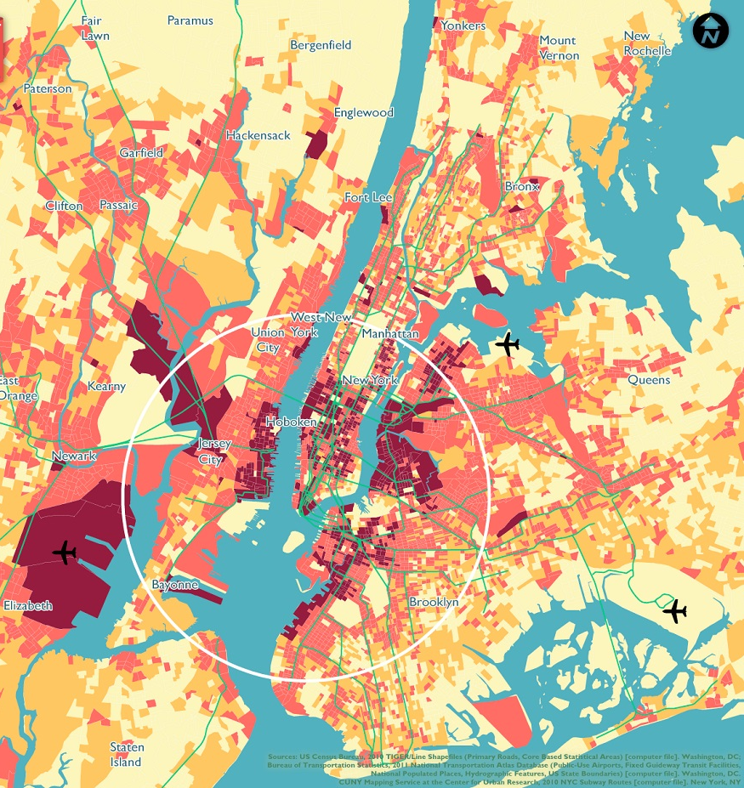
2. Summary of Dataset

Slide 6

Description of Dataset
47906 unique values
16 columns with 16 different variables
Focus on locations, price, room types and reviews

Slide 7

3. Data Visualizations

Slide 8
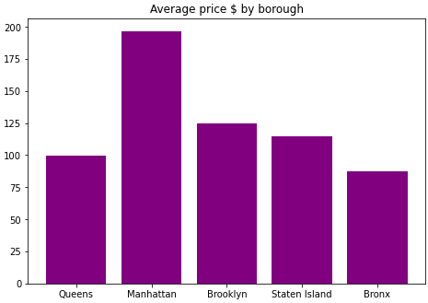
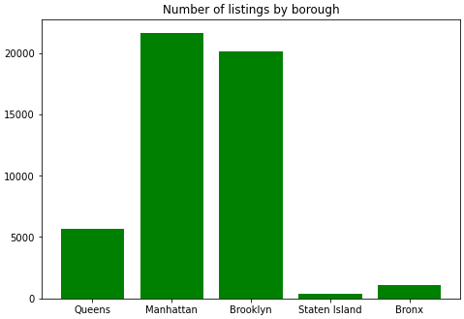
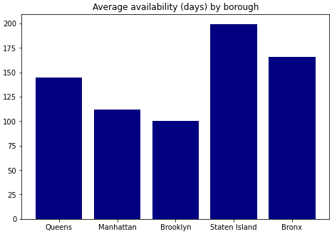
General Observations by Borough

Slide 9
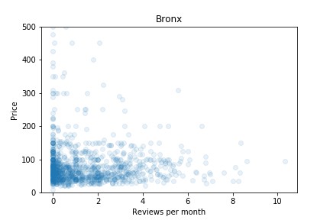
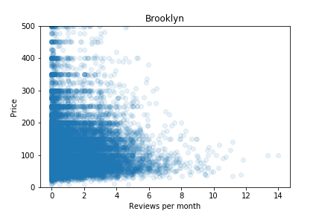
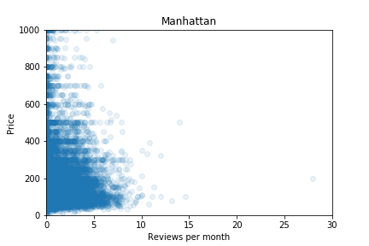
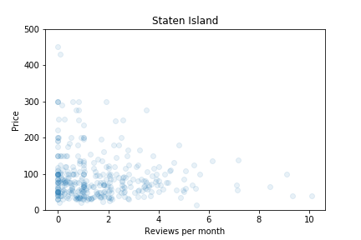
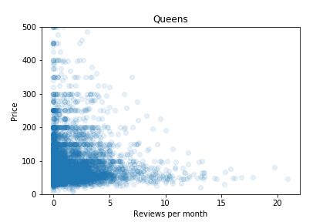
Price vs Number of Reviews Per Month

Slide 10
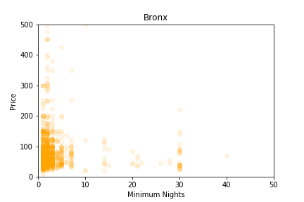
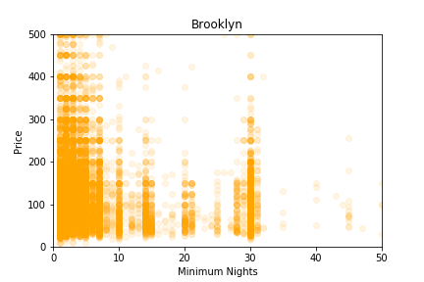
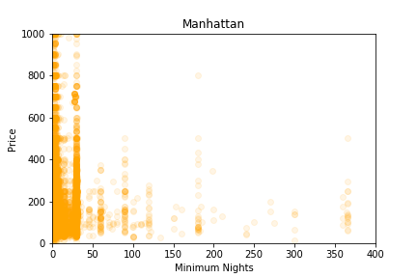
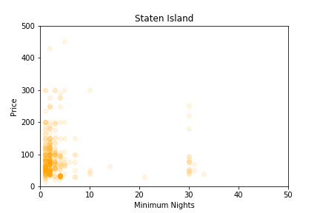
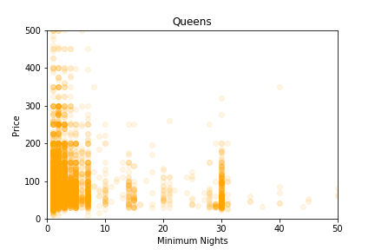
Price vs Minimum Nights
Notes:
Minimum nights go by intervals, clearest in Brooklyn and Queens. For 4 boroughs, after 10, it goes by interval of 5. For Manhattan, it goes by intervals of 30.

Slide 11
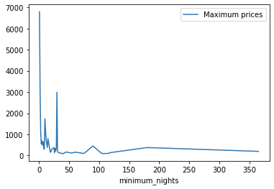
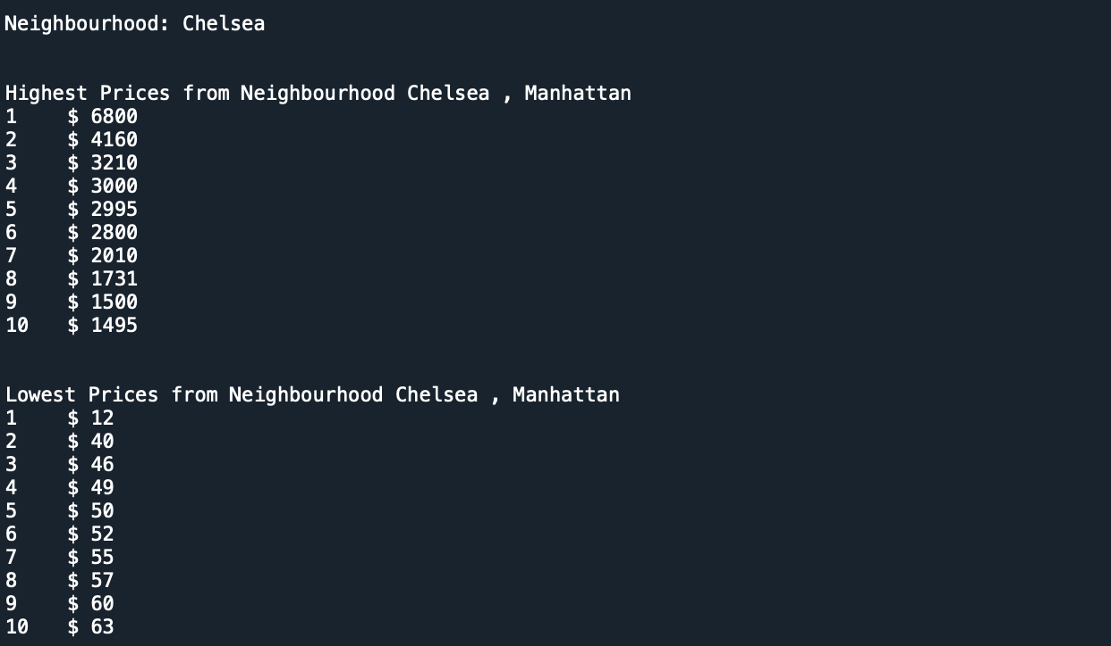
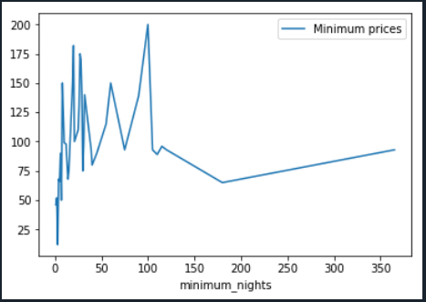
Price by Neighborhood

Slide 12

4. Statistical Analysis

Slide 13
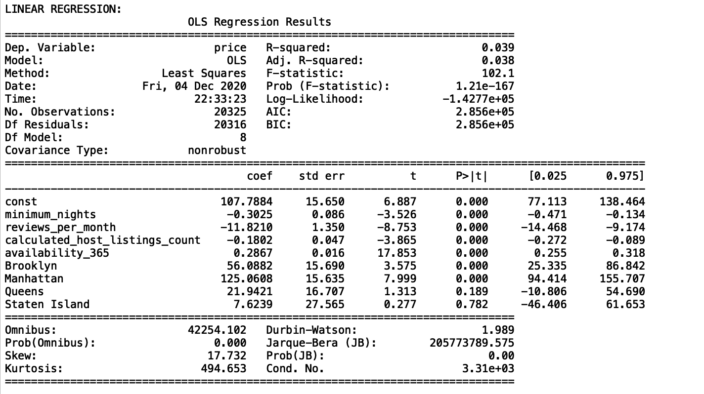
Linear Regression
We did a linear regression analysis to see the effect of the above variables on the price. Although some predictor coefficients are significant but the R-squared value is extremely low (0.039). Only 3.9% of price variability comes from those variables. Therefore the model cannot predict the price. Mean squared error: 92699.09
Notes:
Note that Borough is a categorical variable. It is converted to a dummy variable which is three columns of boolean values.

Slide 14
Regularization
Ridge and Lasso
Train RMSE | 271.95
Train R-Squared | 0.038
Test RSME | 304.46
Test R-Squared | 0.0308
Applying Ridge and Lasso regression as two regularization method improved the Mean Sum of Squares but it did not improve the model over all. Regularization parameter were obtained by 5 fold cross validation. (1 for Ridge and 0.01 for Lasso)

Slide 15
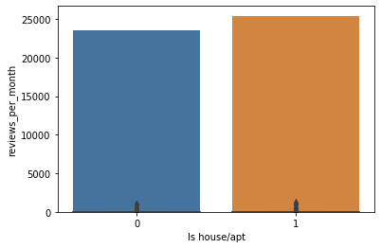
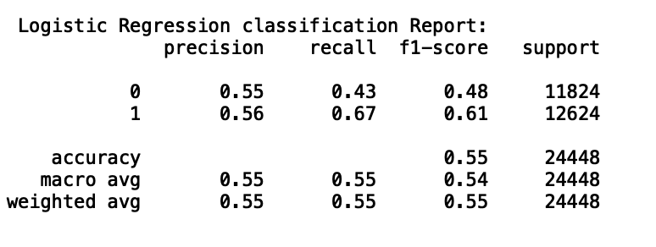
Predict Type of a Property
Binary Classification with Logistic Regression and Random Forest
We would like to see if “Latitude”, “Longitude”, “Minimum nights” “Reviews per month”, “Listing counts” and “Availability” can predict if the property is the entire house/apartment or it is a room.
Logistic Regression Confusion Matrix
5060 (True Negative) | 6764 (False Positive)
4149 (False Negative) | 8475 (True Positive)
Random Forest Confusion Matrix
8049 (True Negative) | 3775 (False Positive)
3472 (False Negative) | 9152 (True Positive)
Accuracy Score
Logistic Regression | 55%
Random Forest | 69%

Slide 16
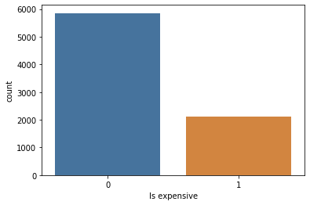
Binary Classification with Random Forest
We would like to see if “Minimum nights” “Reviews per month”, “Listing counts” and “Availability” can predict if the price of a private room in Manhattan is above average or below average by applying Random Forest method. 70% of the data is used for the train and 30% for the test set
Random Forest Confusion Matrix
 | Predicted False | Predicted True
Actual False | 1564 | 165
Actual True | 474 | 148
Standardized Confusion Matrix
0.66 | 0.07
0.20 | 0.06
The score for Random Forest is 0.72. That mean 72% of time it predict correctly whether a room in Manhattan is expensive or not compared to the mean.

Slide 17


Thank you!

